Slide 1


R. N. G. Patel Institute of Technology (RNGPIT)
Computer Science and Engineering Dept.
Semester : 8th
Subject : Internship/Project (3183101)
Backend developer intern
Prepared By:: | Faculty Mentor:: | Industry Mentor::
Pansuriya Darshil J. 180840131033 | Mr. Nikunj Y. Kansara Assistant Professor CSE, RNGPIT | Ms. Priyanka Rajani Team Leader Infozium Solution PVT LTD

Slide 2
Outline
Overview of Company
Introduction of the Internship Work (Purpose, Objective, Scope, Technologies)
Timeline Chart for 12 weeks Internship
Training Work
Project Work
Description of modules on which you have worked
Implementation Work
Test Cases
Problem Encountered by you and Possible Solutions
Summary of Internship
Conclusion
Limitation and Future Enhancement
References

Slide 3
Overview Of Company
Infozium Solution PVT LTD which is Software Solution Base Company which is Located In Surat.
Goal of the Company is that to provide the good and reliable solution to Client. Working on Many Trending Technologies Like React Native ,Flutter, ReactJS, Node JS, PHP etc…
Company have many teams which have experts in that fields of technology and create a multiple solution with their expertise and provide it to client.
Organization have mainly three departments which is Mobile application department, web application department and game department.

Slide 4
Introduction of the Internship Work
Purpose
Main Purpose of an Internship that I wanted to learn new technologies which are use by the companies Nowadays and the real or hands on work within the company and team.

Slide 5
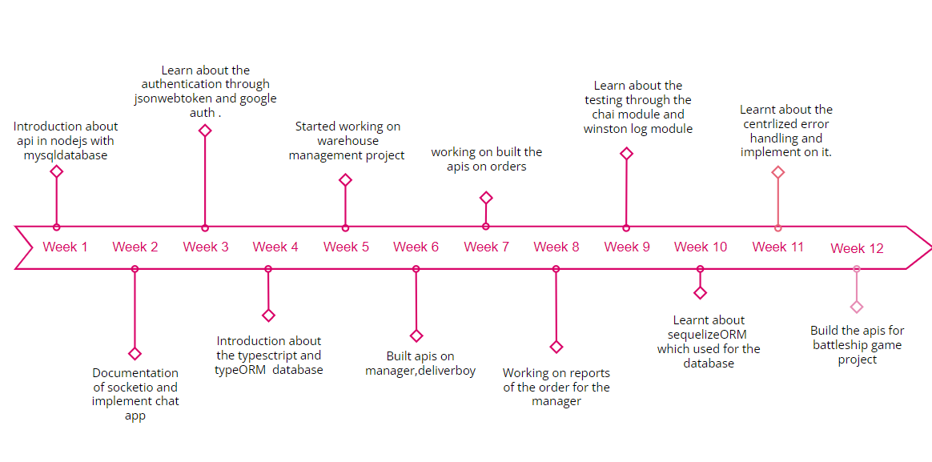
Timeline Chart for 12 weeks Internship

Slide 6
Training Work
Week 1
Learnt about the Javascript’s several object methods such as assign , create , freeze and more.
Later on, Gain the knowledge of HTTP requests like GET, POST, PUT, DELETE and how the REST API Works in Nodejs.[1]
Started working on the practical implementation of rest api in nodejs and intergrating api with the mysql database.
Fetch the data from json file and insert into mysql database and create api on those data.

Slide 7
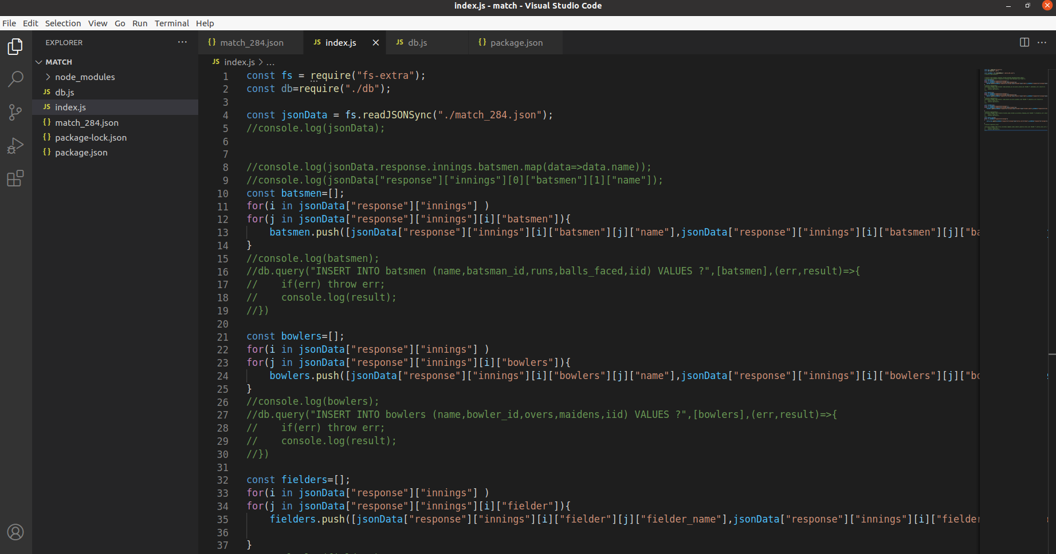
Training Work
Week 1

Slide 8
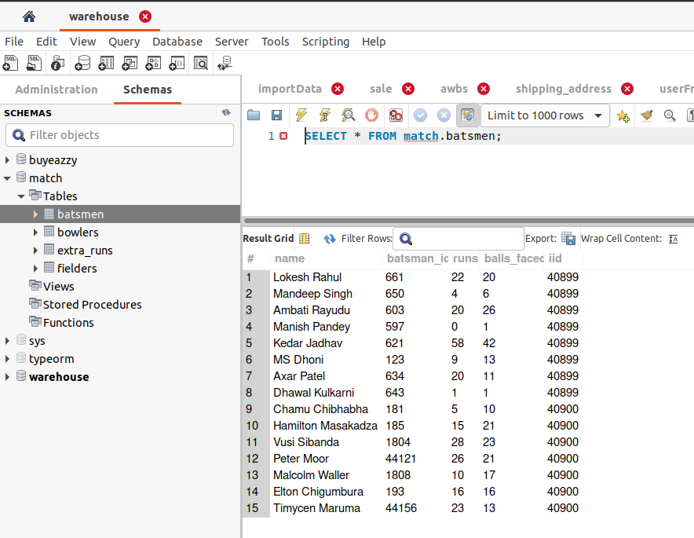
Training Work
Week 1

Slide 9
Training Work
Week 2
Working on the file module and validate the file uploadation in nodejs.
Learnt documentation about the socketio which is bi-directional communication between web clients and servers. It has two parts: a client-side library that runs in the browser, and a server-side library for Nodejs.
Build the simple chat app using the socketio in which users enter into rooms and chatting with each other.

Slide 10
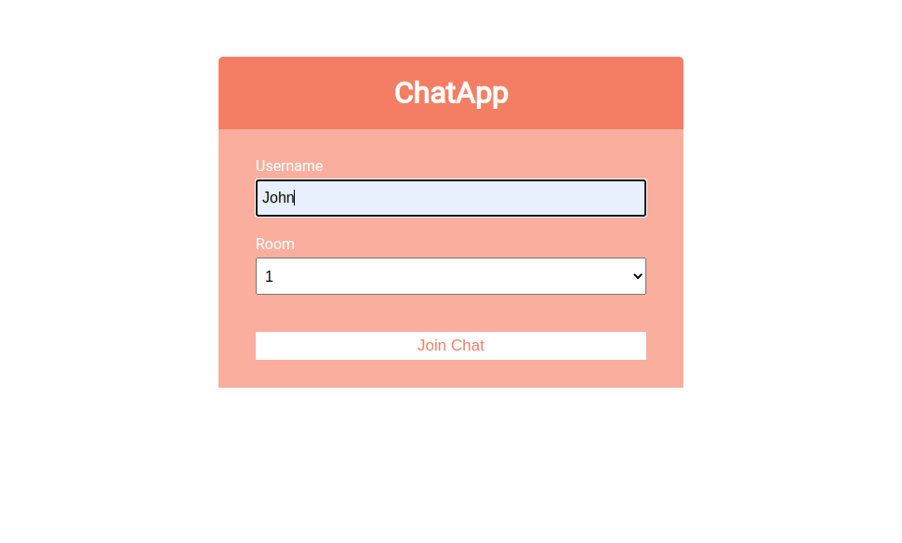
Training Work
Week 2

Slide 11
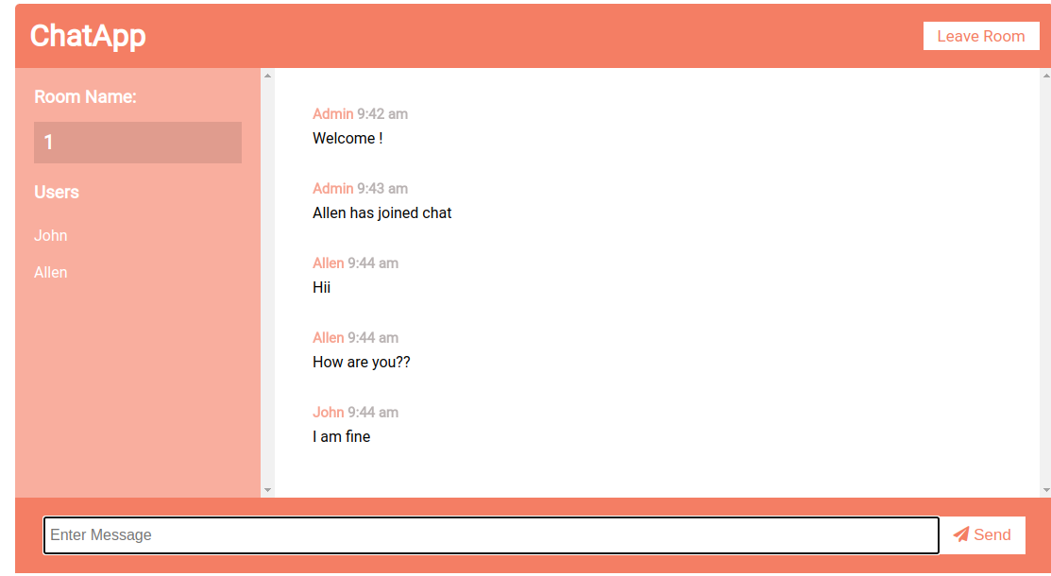
Training Work
Week 2

Slide 12
Training Work
Week 3
Learnt about the JsonWebToken which used for the authentication a user.
Implementation of jsonwebtoken with the accesstoken and the refreshtoken.
Implement passport-local-stratergy which is used for the authentication.
Google based authentication and facebook based authentication implement using the passport stratergy.

Slide 13
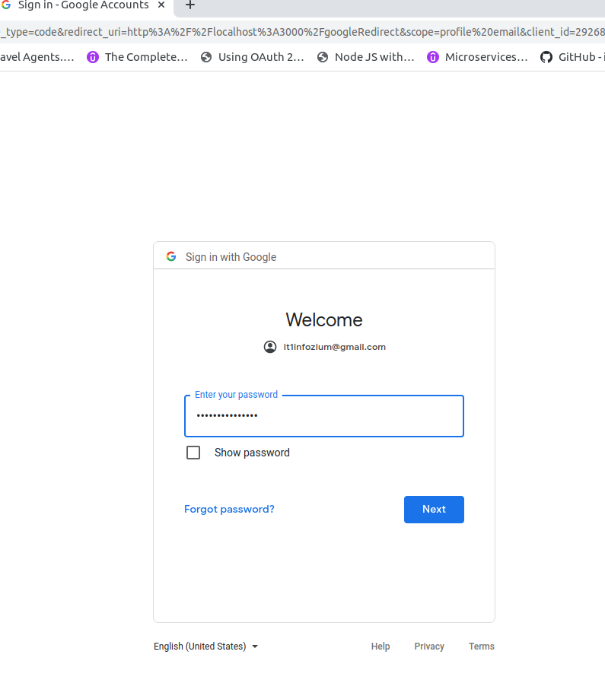
Training Work
Week 3

Slide 14
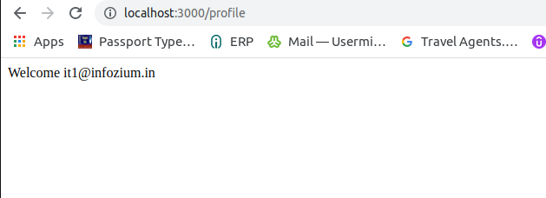
Training Work
Week 3

Slide 15
Training Work
Week 4
Overview of typescript, basic syntax of typescript, type annotations and inference.[3]
Learnt about the typeORM which is Object Relational library.
In typeORM entities, embeded entities, relations one to one , many to one, one to many.
Learnt the Select , insert, update, delete Query builder which is used for the CRUD operation.[4]
Implementation of the CRUD operation and relations between the entities.

Slide 16
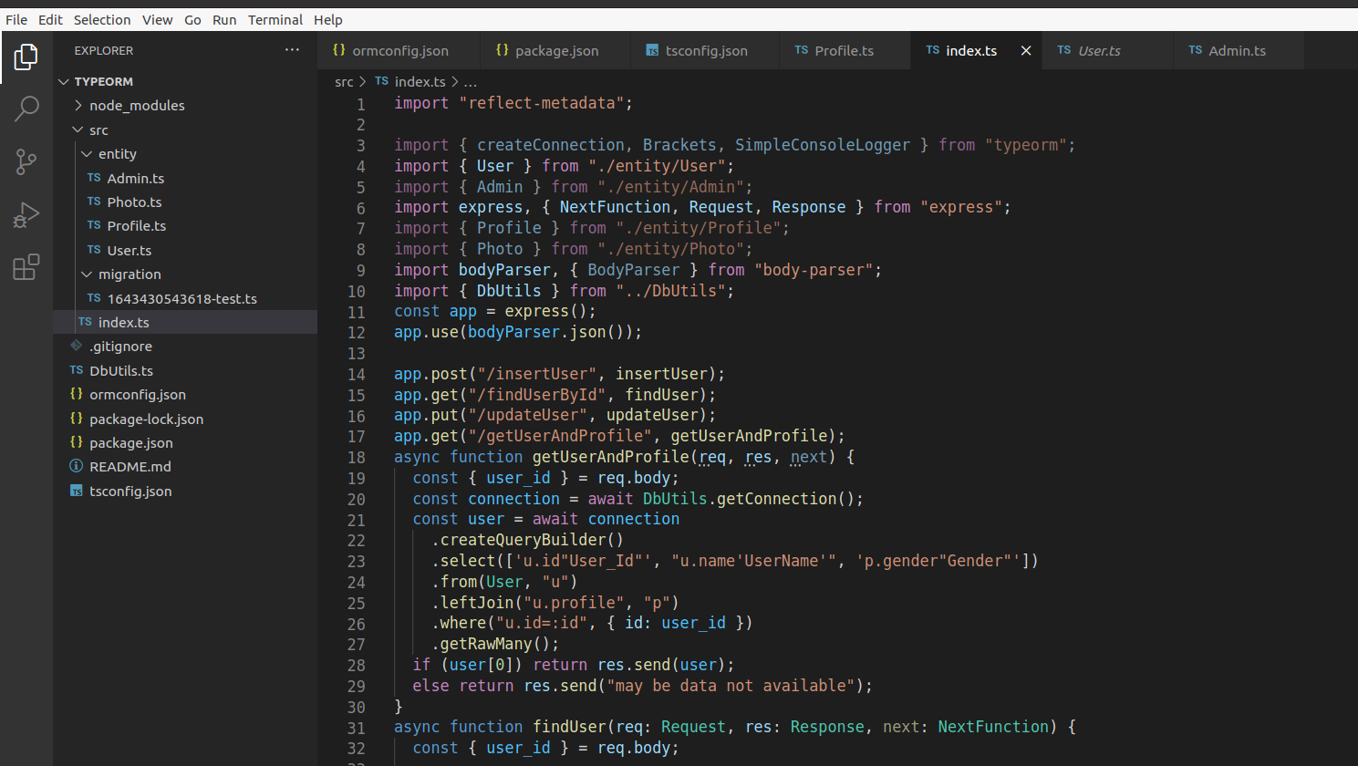
Training Work
Week 4

Slide 17
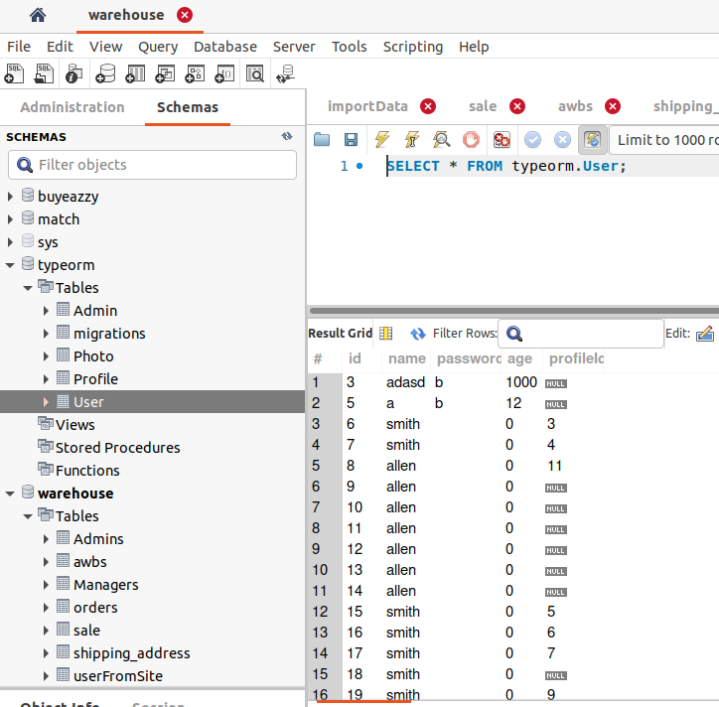
Training Work
Week 4

Slide 18
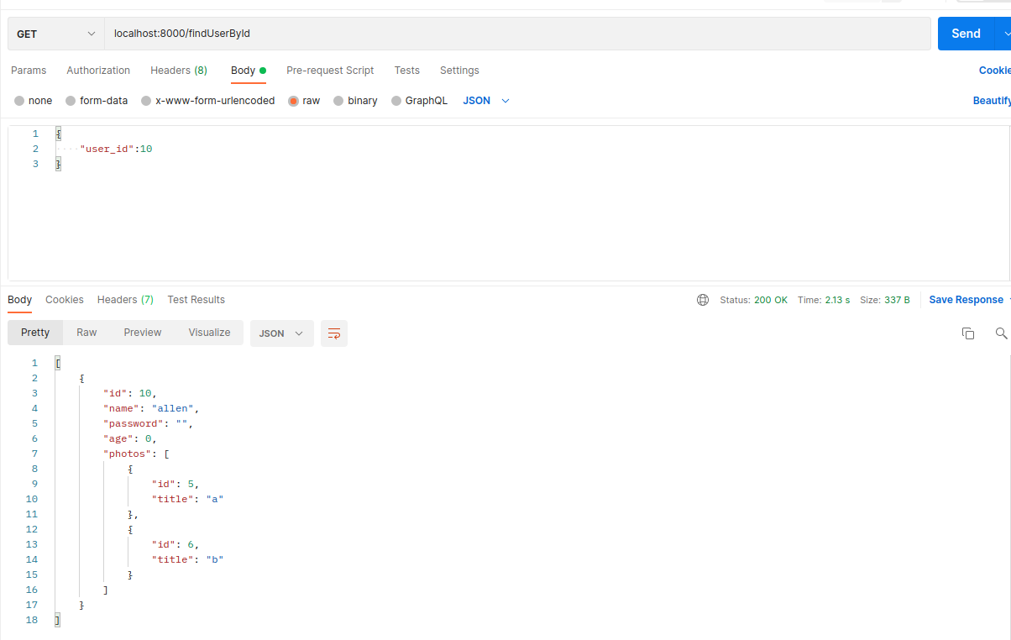
Training Work
Week 4

Slide 19
Project Work
Warehouse management
Warehouse Management is based upon delivery services. It has mainly three Roles are Admin, Warehouse Manager and Delivery Boy In which admin and warehouse manager uses the web app and delivery boy uses the mobile app.
Admin can add/edit/delete Warehouse Manager and Delivery Boy as well apart from that admin can view/ edit delivery boy and Warehouse Manager. Admin can Manage, view, Assign Orders to Managers and Delivery Boys.
Warehouse Manager will assign order to Delivery Boy and Download status of order and Payment Collection report.
Delivery Boy accept the order and Delivered the order and update the status of order and collect the payment.

Slide 20
Project Work
Technology required for the Project
For web application ReactJs used for the front-end and Nodejs used for the Backend those both framework of the javascript.
Mysql database used for database.
Mobile application build through the Flutter Technology which uses the Dart programming language.

Slide 21
Project Work
Description of modules
Admin Manages Warehouse Manager and Delivery Person
In this module I’ve developed APIs for Create, Edit, Block the Warehouse, Warehouse Manager, Delivery Person.
Manager can upload order and assign order
In this module I’ve developed APIs for manager can upload orders, view all orders, view assign orders, delivery type of orders, assign orders to delivery person.
Admin and Manager can view reports of orders
In this module, I’ve added APIs for manager and admin can check the status of order by particular Delivery person and the from and to Date and also download the payment collection report.

Slide 22
Project Work
Week 5
In fifth week get Introduction about the warehouse management project which client’s project.
This project basically based upon the delivery service by the agency for e.g. Ekart Logistics.
It has main three roles admin, warehouse manager and Delivery Boy.
Build the Register and Login api for the Delivery Boy and Warehouse manager which is used by the admin.
Create Delete, update,block, unblock api for the delivery boy and warehouse manager which is controlled by the Admin.

Slide 23
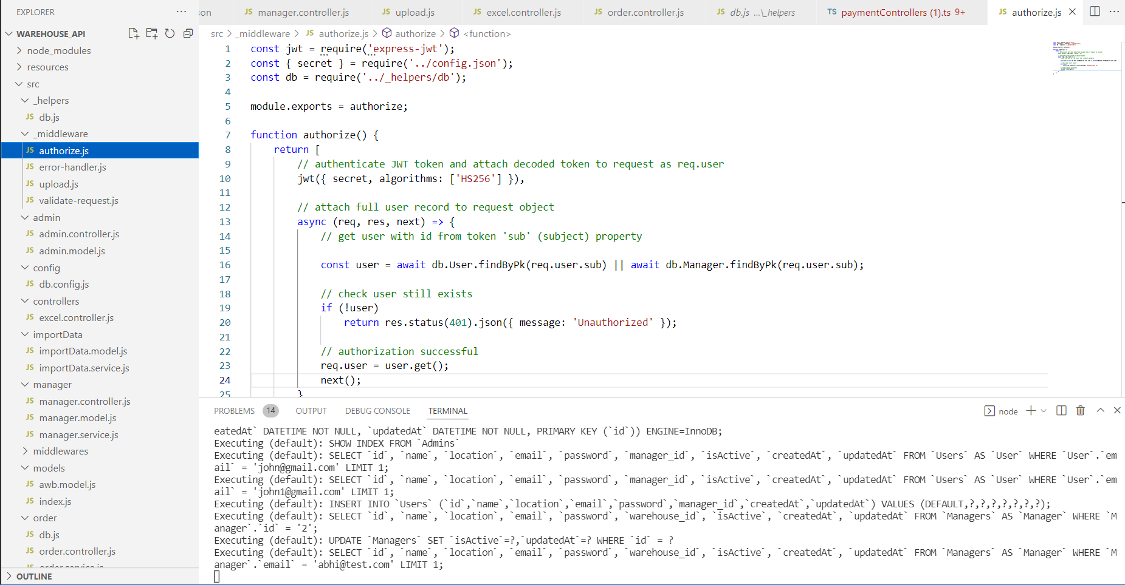
Project Work
Week 5

Slide 24
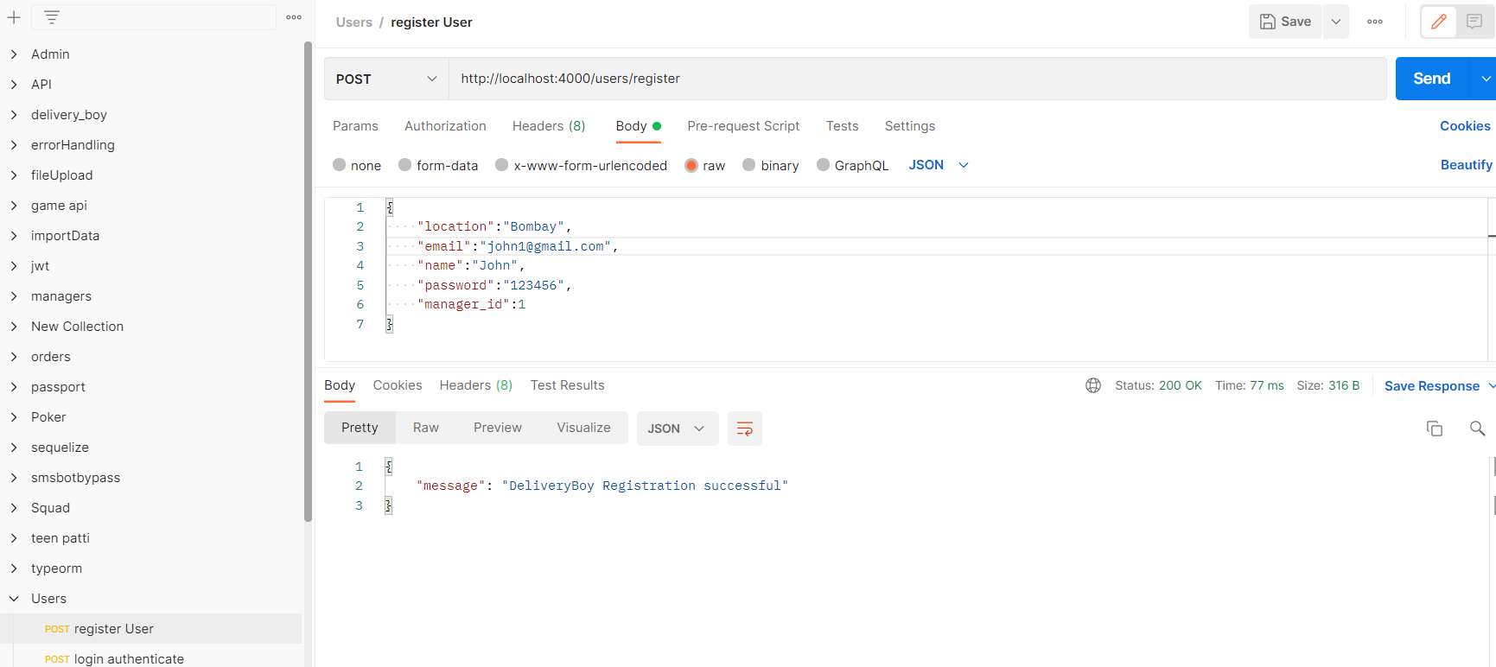
Project Work
Week 5

Slide 25
Project Work
Week 5

Slide 26
Project Work
Week 6
In 6th week build the API of create, get, update, delete for the warehouse.
Build the api for upoad excel file and file data insert into the database.
Create the api for order assign by the warehouse manager to the Delivery Boy and Delivery Boy view the all assigned order.
Build api of view order between the from date and to date.

Slide 27
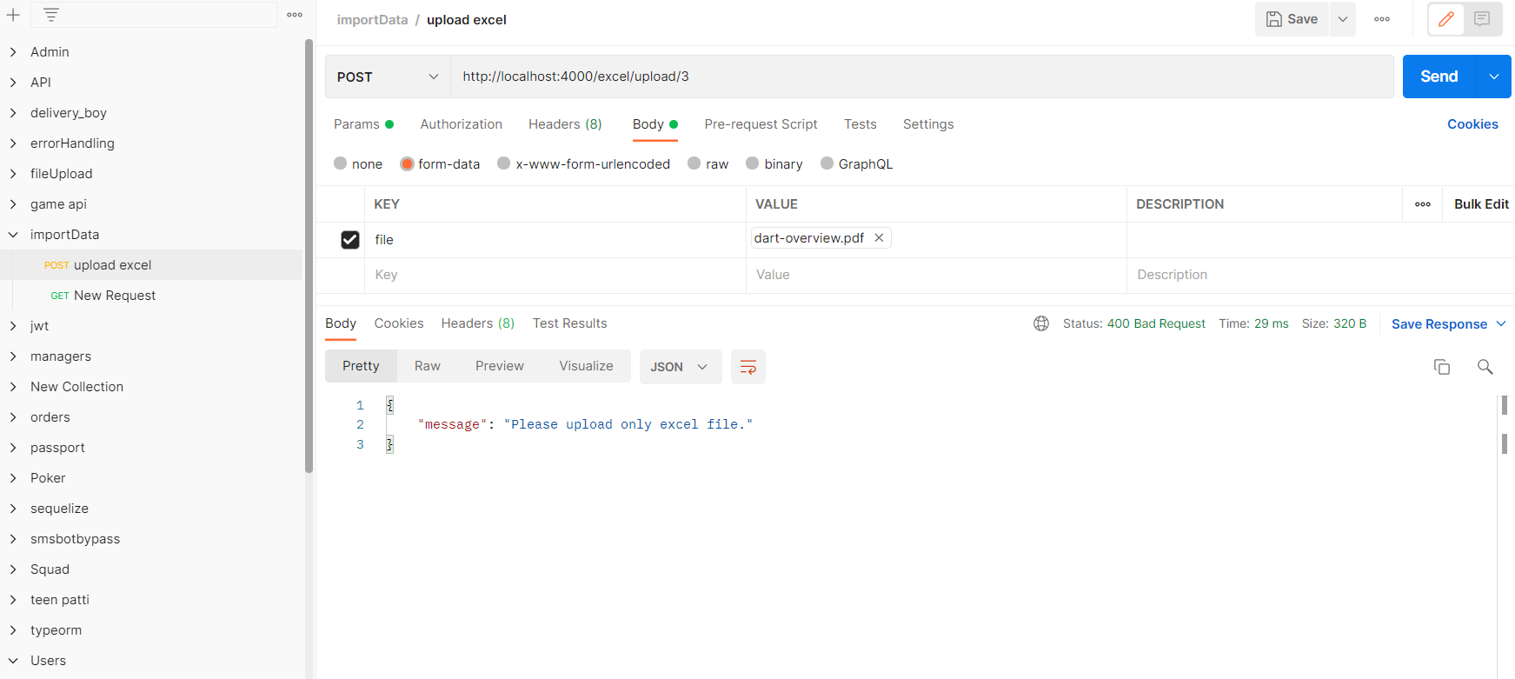
Project Work
Week 6

Slide 28
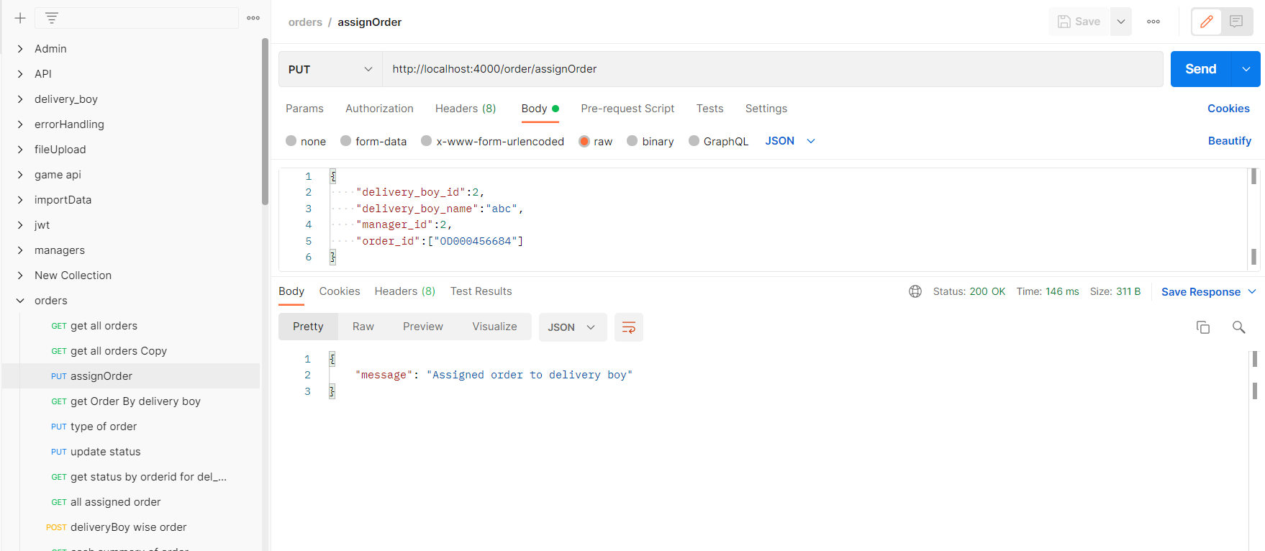
Project Work
Week 6

Slide 29
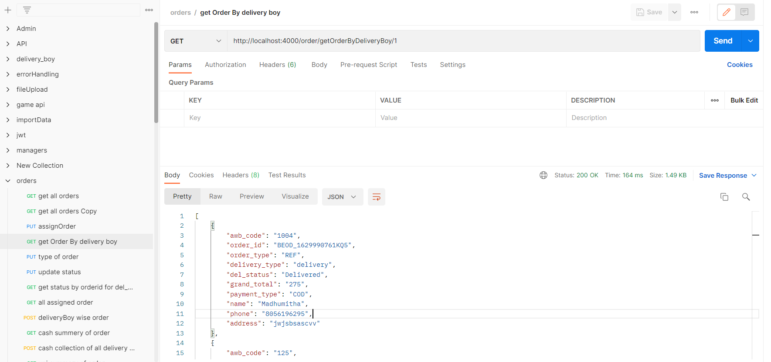
Project Work
Week 6

Slide 30
Project Work
Week 7
Build the status update of order by delivery boy api and solved error on it.
Working on changes in api and build the view all assigned order and status of order api.
Create the delivery boy wise and datewise api and changes on it.
Made the changes in view all order and assign order api and build the api of cash summery of delivery boy for the manager.
Working on excel sheet download of cash collection by delivery boy api.

Slide 31
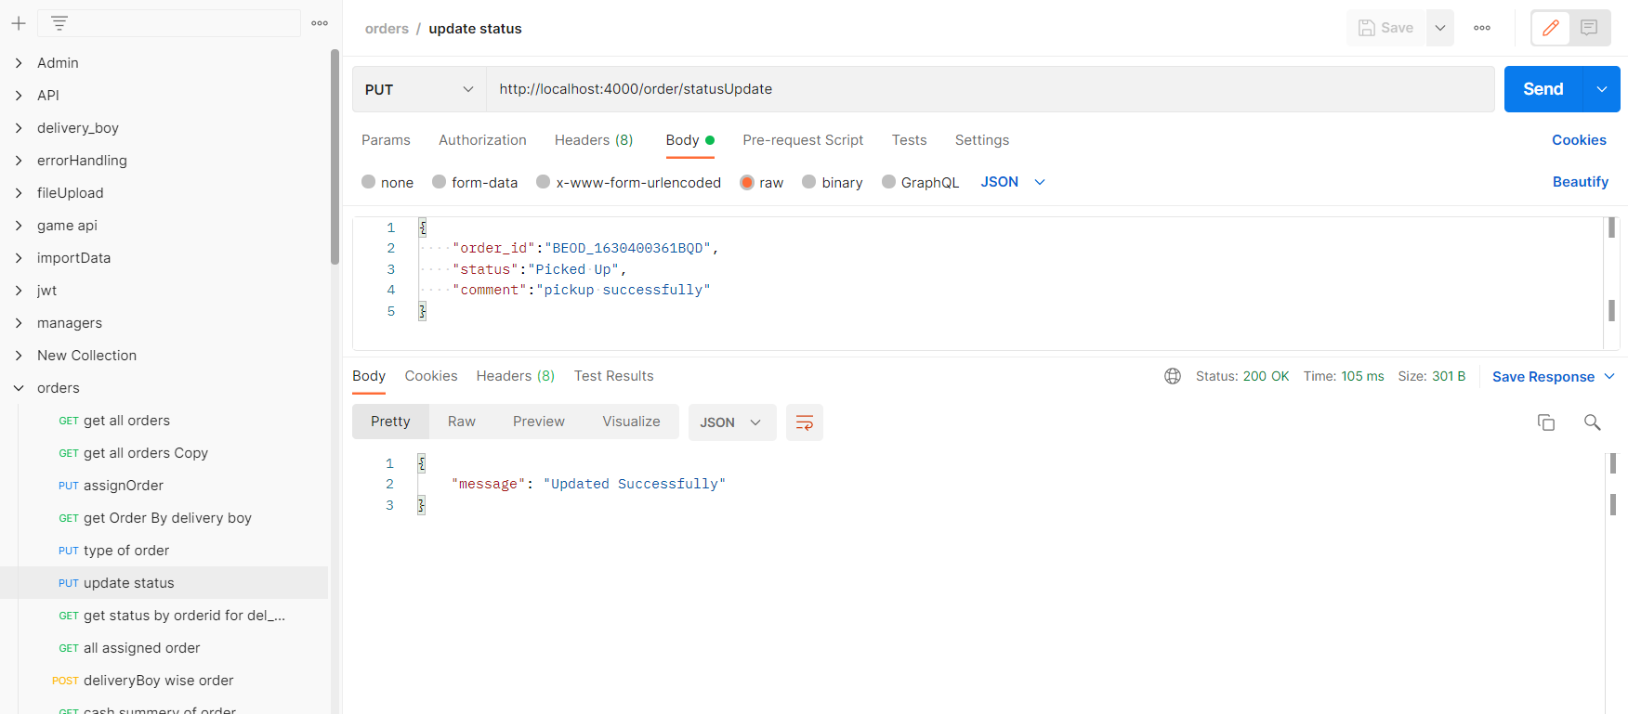
Project Work
Week 7

Slide 32
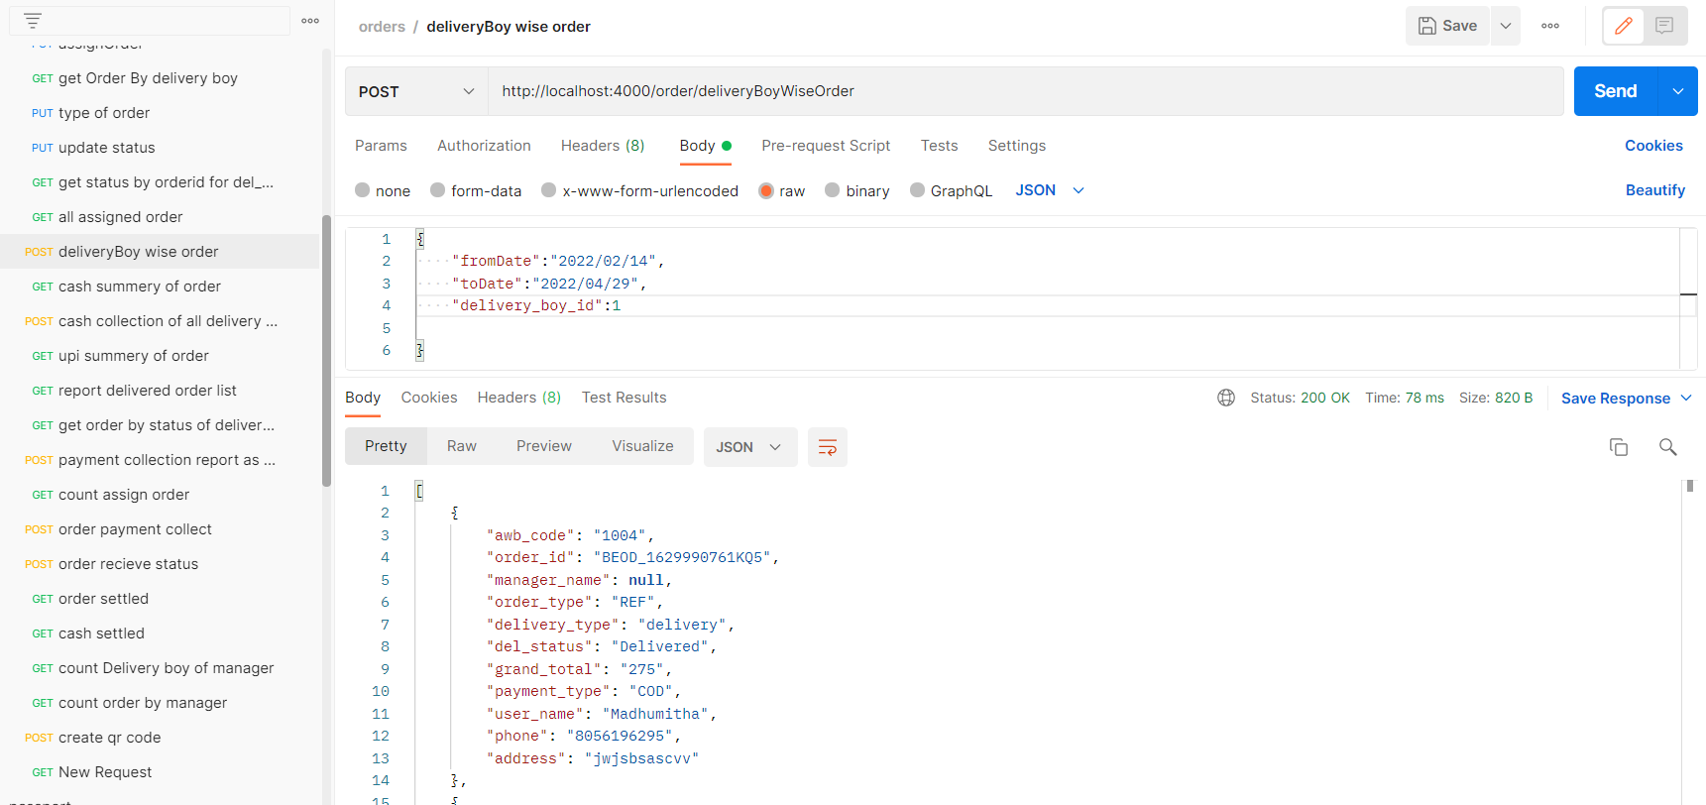
Project Work
Week 7

Slide 33
Project Work
Week 8
Working on build get order by the status updated by the delivery boy and report of delivered order api.
Build the api for cash collection by delivery boy for the manager .
Create the track order as per order status for the delivery boy and changes in payment collection report.
Made the changes in api and fix issues.

Slide 34
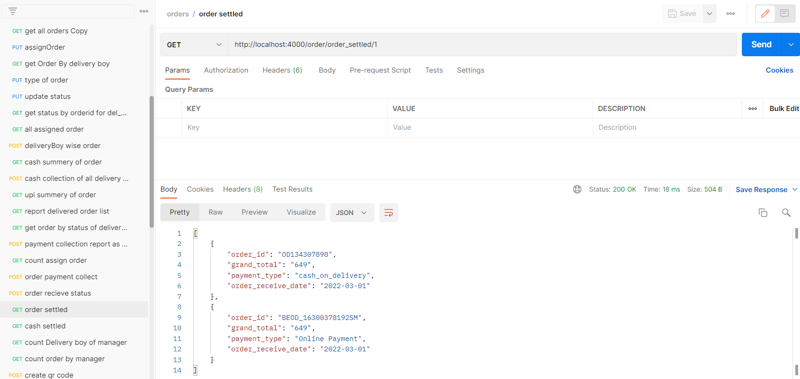
Project Work
Week 8

Slide 35
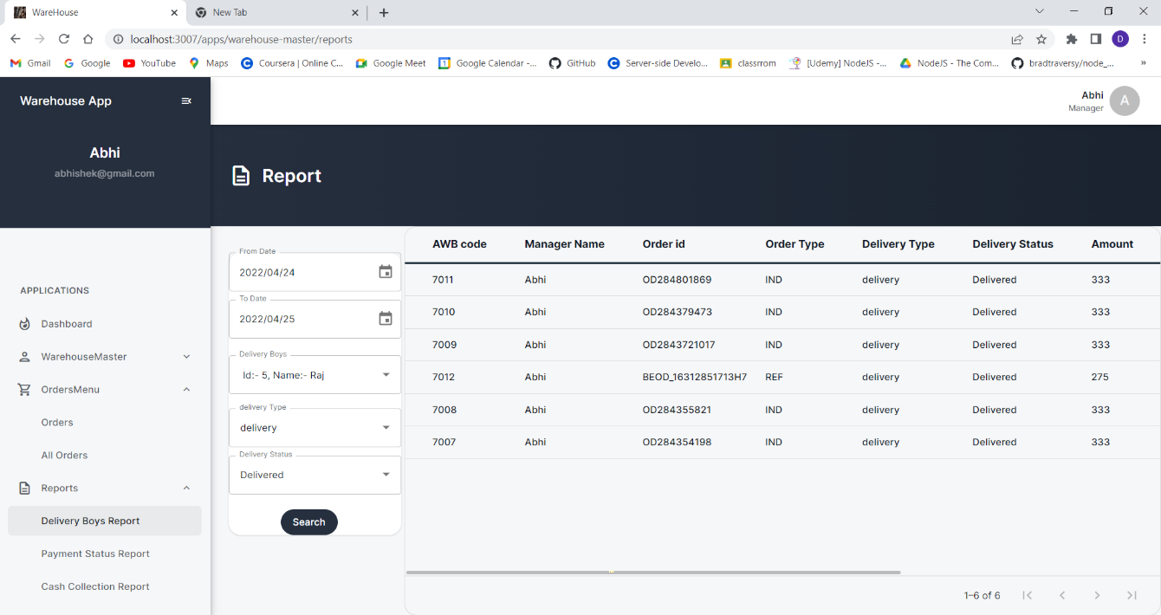
Project Work
Week 8

Slide 36
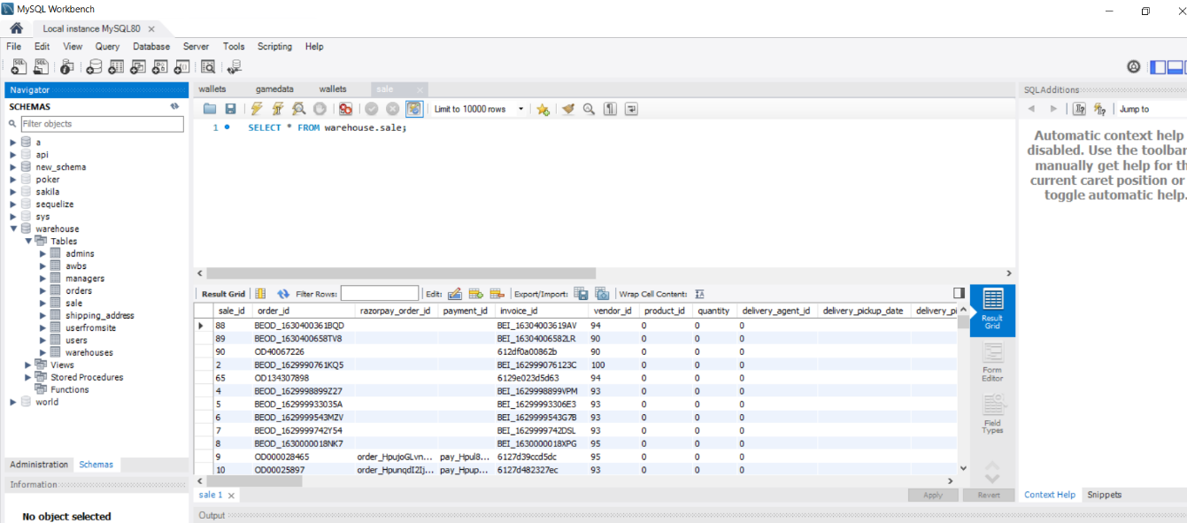
Project Work
Week 8

Slide 37
Test Cases
TestID | Case | Test Data | Expected Result | Actual Result | Pass/Fail
1 | User Interface | N/A | UI should be perfect | Click on all buttons and check if they are working or not | Pass
2 | Required Fields | N/A | * should show asking for mandatory field | Do not enter any value in mandatory field and click on create manager | Pass
3 | Email validation | N/A | While creating manager and delivery person enter duplicate email then show the validation message | Show the email already taken message | Pass
5 | Duplicate Data | N/A | Manager upload excel file if it contains the duplicate data then shows the message duplicate data | Please select unique data and failed to upload | Pass
6 | LogIn Validation | N/A | If Manager and Delivery person blocked by admin so thay can not be login | You are blocked message shows | Pass
7 | File validation | A.pdf | Manager upload file except excel then dhould gave the message og upload excel file | Please upload an excel file message shows | Pass
8 | Wrong url | N/A | If manager enter wrong url in browser than shows Requested path not found | Requested Path not found | Pass

Slide 38
Problem Encountered by you and Possible Solutions
Encountered several problems during the development of projects. some of those problems are mentioned below:
Faced difficulties while uploading the excel file and downloading excel file which contains the data.
For that problem found the exceljs and read-excel-file/node module and use of them.

Slide 39
Summery of internship
To experience the practical working of what we studied in the book theories, is very interesting, memorable and very important in our education. Doing internship is my first experience of working for any company and learn how the things are being done in the actual industry.
This internship has been an excellent and rewarding experience. During this internship I Learn about the how the projects being develop in the actual industry Also know about the company works and deals with the big clients.

Slide 40
Conclusion
Learnt about the new technologies and gain the practical skills on it.

Slide 41
Limitation and Future Enhancement
Warehouse management system used for the delivery of orders of the large ecommerce application.
In Future learn about the different different socket related library which is used into the back-end development of game.

Slide 42
References
[1] NodeJS:
https://www.udemy.com/course/the-complete-nodejs-developer-course- 2/learn/lecture/13729518#overview
[Accessed: 05-Jan-2022]
[2] JWT Token Implementation:
https://www.section.io/engineering-education/how-to-build-authentication-api-with-jwt-token-in-nodejs/
[Accessed: 26-Jan-2022]
[3] Sequelize ORM:
https://sequelize.org/docs/v6/
[Accessed: 28-Jan-2022]
[4] Upload and download excel file in NodeJS:
https://www.bezkoder.com/node-js-upload-excel-file-database/
[Accessed: 10-Feb-2022]

Slide 43
THANK YOU

